Slide 1
Game Development
WS-20/21
TU-Ilmenau
Presentation on-
Play Ball in VR
Group-9:
Munim Ahmed
Sadia Ferdous Snigdha
Syed Muhammad Saleh Arfi
Nabeel Asim
Supervisor: Tobias Schwandt
Date:09.12.20
<number>

Slide 2
MOTIVATION
To develop a VR game
Experiencing the virtual world
Experiencing the properties of physics in VR
Hands on experience with grabbing and throwing objects in VR
<number>

Slide 3
PROJECT DESCRIPTION
An interesting VR game
The scene contains a virtual 3D room including some moving objects as well as fixed objects
Game objects are few balls which will be placed somewhere in the room
The main goal is pick up one ball and throw it to the target object
If it collides with any walls or any fixed object the game will restart, hence no scores obtained
Score will be earned by clearing the moving targets of the entire room
Notification texts will be generated after clearing each target and also when the ball collide with the Furniture/fixed objects
<number>

Slide 4
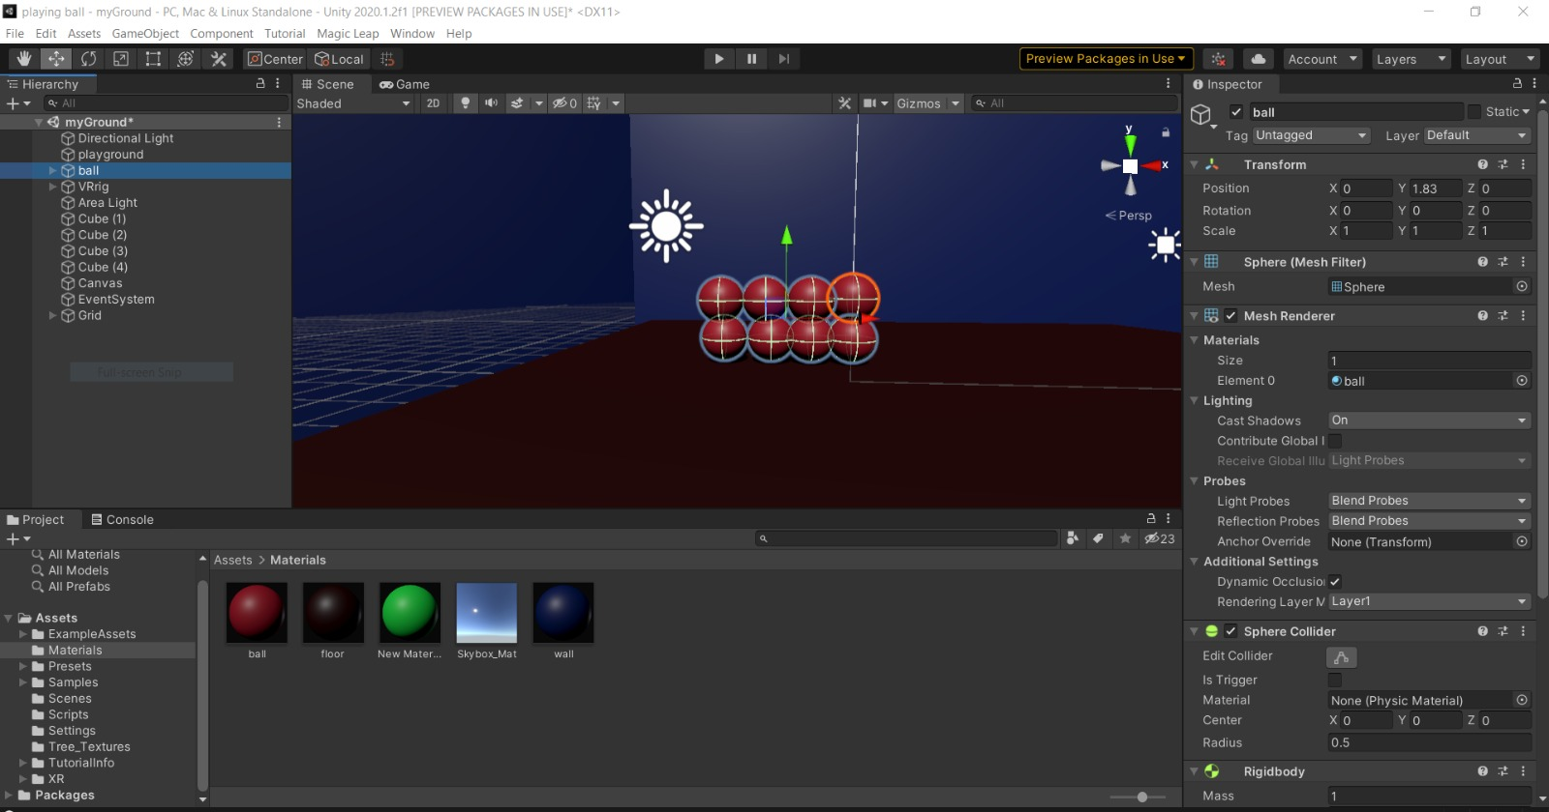
USE CASE DIAGRAM
<number>

Slide 5
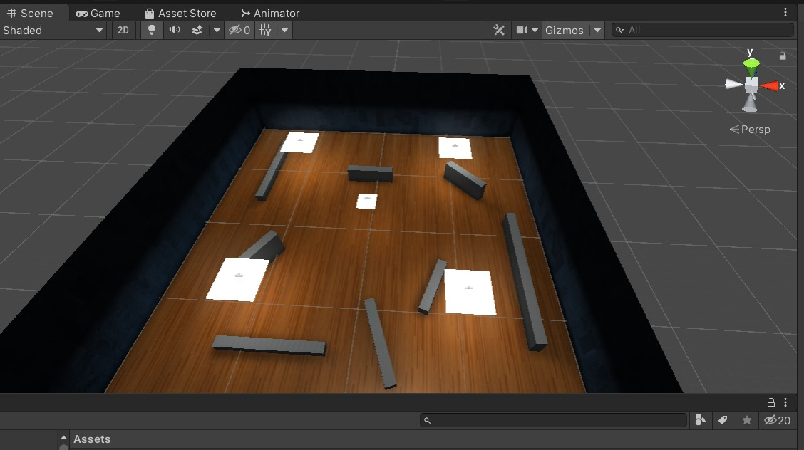
USE CASE DIAGRAM
<number>

Slide 6
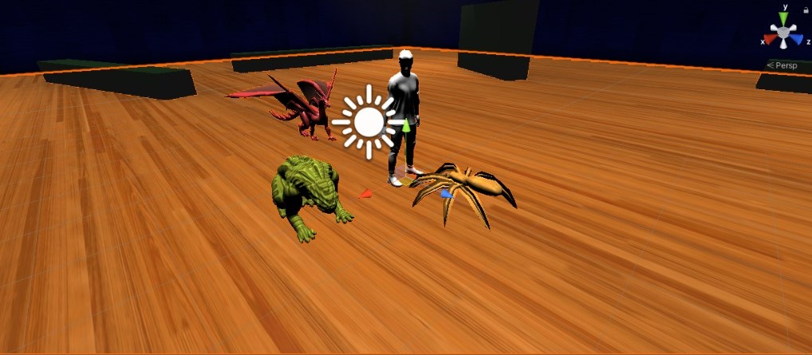
Accomplished so far…
<number>

Slide 7
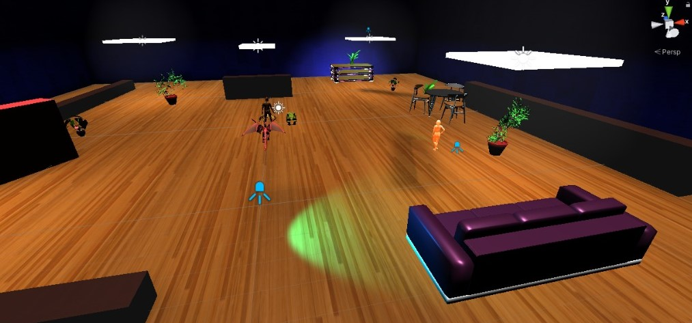
Accomplished so far…
<number>

Slide 8
What's New!
Added animation to the characters
Increased the number of characters
Added some new scripts
<number>

Slide 9
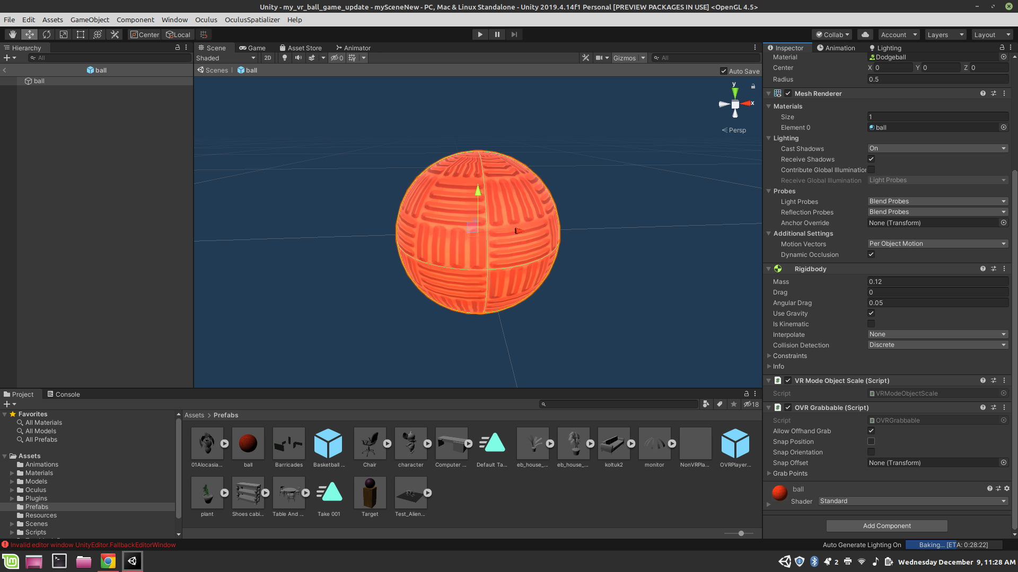
What's New!

Slide 10
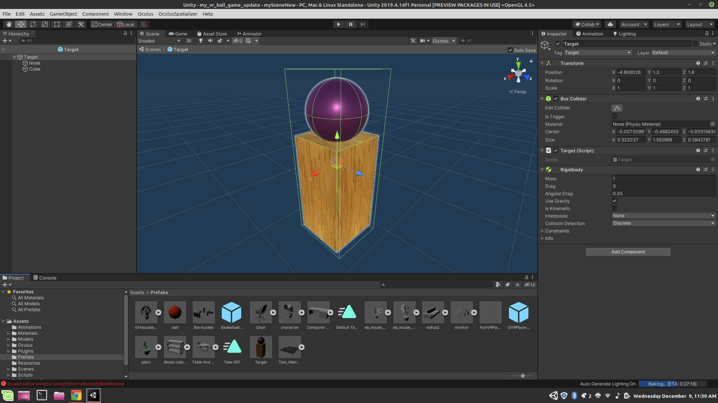

Slide 11
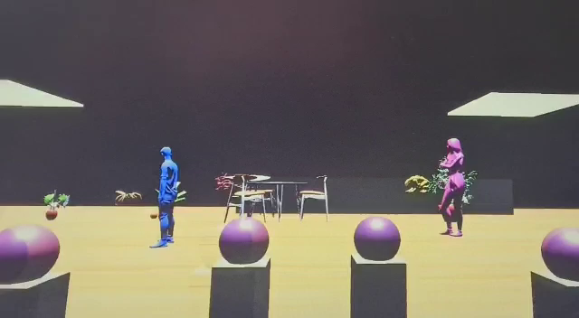
What's New!

Slide 12
Technologies
Interections:
Grabbing with hands
Detecting the movements of hands
Tracking the movements of head
Detecting force/ mass
Detecting player's movement
Controllers & Software:
Unity Editor
Oculus Rift Touch controllers
Oculus Rift HMD
Oculus Sensors
C# Programming language
<number>

Slide 13
Thank You !

